Slide 1
Virginia Housing Opportunity Tax Credit

Slide 2
Sugar Creek Overview
Sugar Creek is a national leader in state low-income housing tax credit investments that benefit working families and fixed-income seniors.
Investing in 12+ states
Provide equity up front
Active in legislative advocacy
Our work shows that the most efficient
way to leverage the federal LIHTC is with
a state LIHTC.

Slide 3
Program Design – Housing Opportunity Tax Credit
State authorizes HFA to make annual awards
HFA sets real estate standards and competitive criteria (QAP)
HFA already has strong, existing competitive federal funding pool
Developers compete annually for HFA credits
HFA does intensive underwriting, construction, and policy review
State credits allow HFA to stretch federal credits much further to fund more deals
Awarded Developers find investors and begin construction
Equity partner[s] contribute private capital to build in exchange for credits
Credits cannot be claimed until properties are built and begin lease-up
State credits simply piggyback on the existing, established infrastructure
State credits also make bond-funded deals possible that aren’t otherwise
HFA has oversight obligation for 15- to 30-year period with claw backs

Slide 4
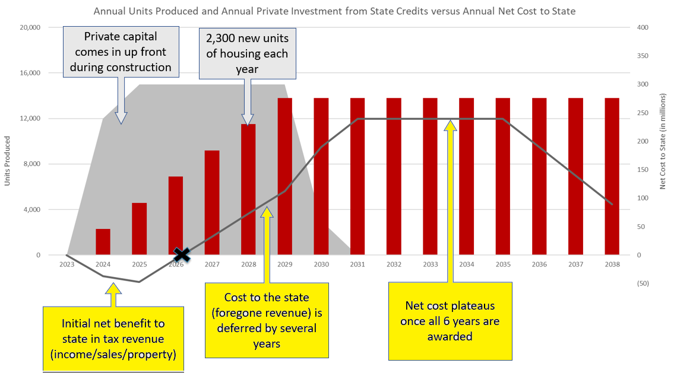

Slide 6
How State Credit Can Benefit
9% Rural
No State Credit
State Credit Gap Filler
State Credit Match

Slide 7
A few key points:
A tool in the economic development toolbox
Businesses cannot invest or expand without a workforce
Private alternative to gov’t-built and gov’t-run housing
30+ year history of success: state oversight (claw back); investor oversight; waiting list for new projects
The private market can’t solve the supply issue

